Slide 2
Your first application with Couchbase
Developer Advocates @ Couchbase

Slide 3
Setting up the Project github.com/sideshowcoder/Dev-Day-UpDownApp
Notes:
https://github.com/sideshowcoder/Dev-Day-UpDownApp

Slide 4
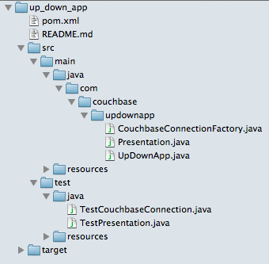
Maven Project Layout

Slide 5
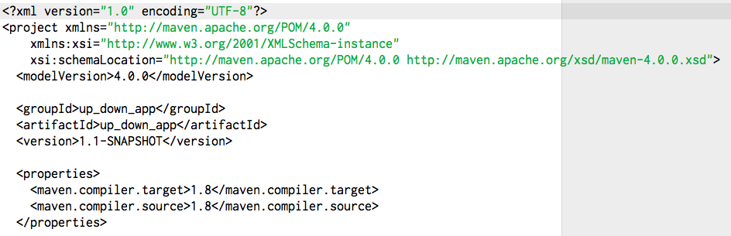
The Maven File pom.xml

Slide 6
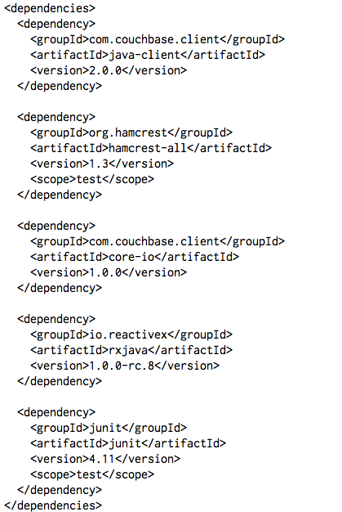
The Maven File pom.xml

Slide 7
Connecting to Couchbase

Slide 8
Couchbase Smart Client

Slide 9
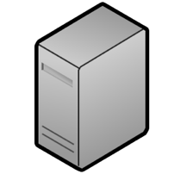

Client Setup: Getting Cluster Configuration
make connection
receive topology
Couchbase Client
App Server
Notes:
Couchbase client
Basically, give people an overview of how the SDK’s get notified when there is a topology change via async REST.
On the SDK side, we make sure the SDK’s as much as possible, get to the know the new cluster config – over streaming API.

Slide 10
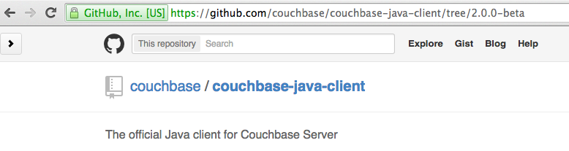
Developing Test First Look at the code for guidance

Slide 11
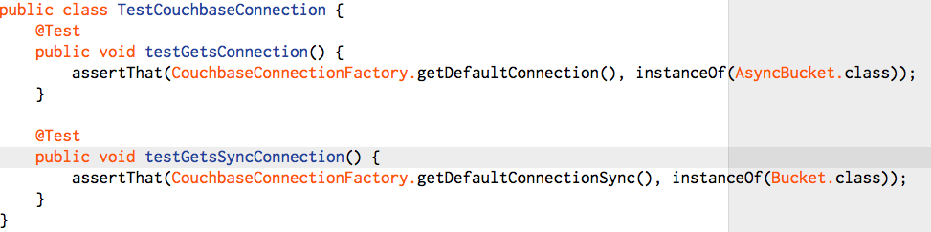
Making a Connection
Notes:
Run with maven test

Slide 12


Implementing a Connection
Sync
Async

Slide 13
The app

Slide 14
Up / Down Vote
Users vote can create presentations
Users can vote presentations up or down

Slide 15
The end result

Slide 16
Presentation
Plain old Java object (POJO)
Follows an Active Record Pattern
Fields
UpVotes
DownVotes
CreatedAt
Title

Slide 17
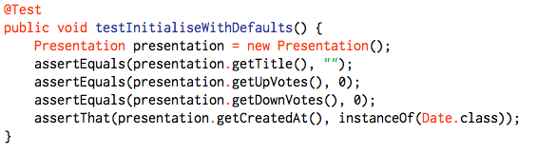
Creating a new Presentation

Slide 18
Storing in the Database
Create a key
Serialize the POJO
Insert as a new document
Replace if it was inserted before

Slide 19
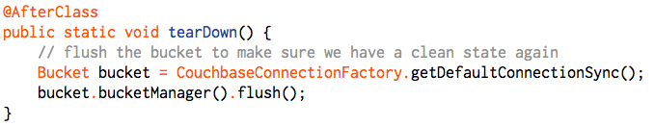
Making sure we have a clean DB to start

Slide 20
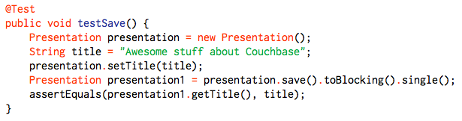
Saving
Notes:
Saving should create a new presentation

Slide 21
Serializing to JsonDocument
JsonDocument is the unit the SDK operates on
It provides an abstraction over JSON
All operations are expressed as operations on JsonDocument

Slide 22
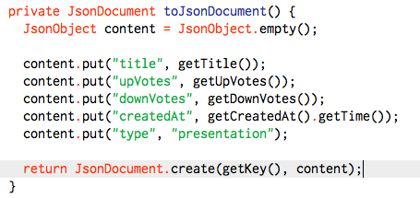
toJsonDocument

Slide 23
De-serializing
Extract information from JsonDocument
Create an instance of the POJO

Slide 24
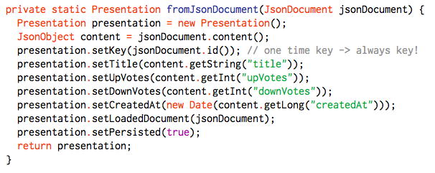
fromJsonDocument

Slide 25
Saving
Serialize the POJO
Store in the Database
Generate a new POJO to return
Everything is asynchronous!

Slide 26

Save

Slide 27
Updating

Slide 28

Updating is easy!

Slide 29
Managing concurrency
Optimistic locking
Actor 1
Actor 2
Success
CAS mismatch!
Couchbase Server
Notes:
If we have two different app servers trying to update the doc, the first one that gets there using the CAS value, will win. The second will fail.
Every time any data is changed in a document, the CAS value changes. If we use the same CAS twice, it’s not going to work twice.

Slide 30
Using compare and swap
Store the CAS Value on load
Use replace to update documents
Include CAS in every operation

Slide 31
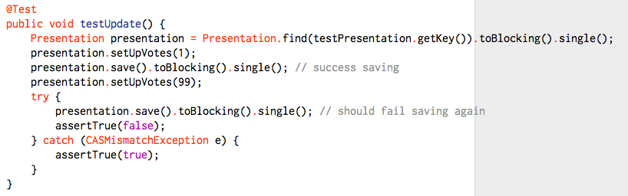
Updating Test

Slide 32

Implantation
Keep the loaded document around to retain the CAS value

Slide 33
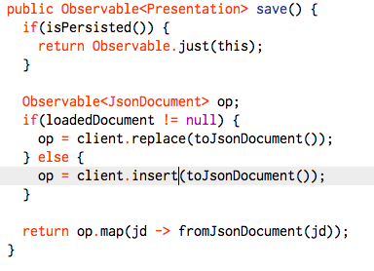
Implementation

Slide 34
Listing all Presentations

Slide 35
Couchbase Views
Allow to query on 2nd indexes
Index any properties you like
Do range queries (This is what we need!)

Slide 36
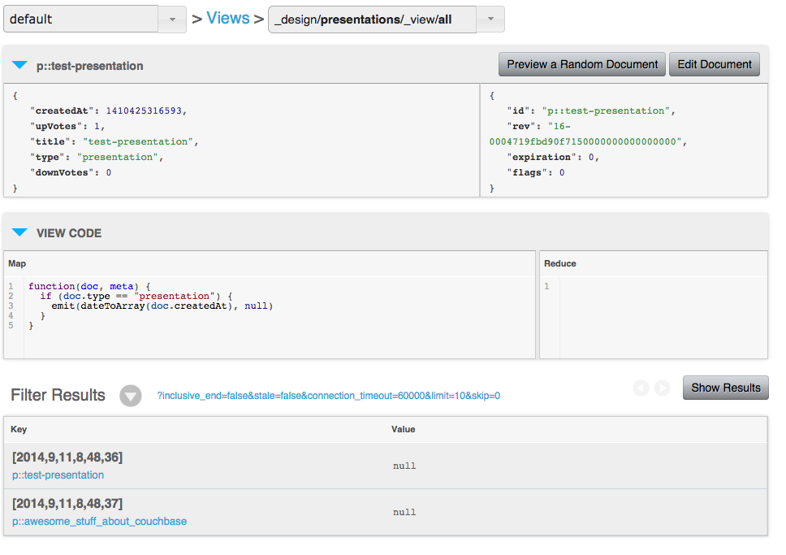
Views

Slide 37
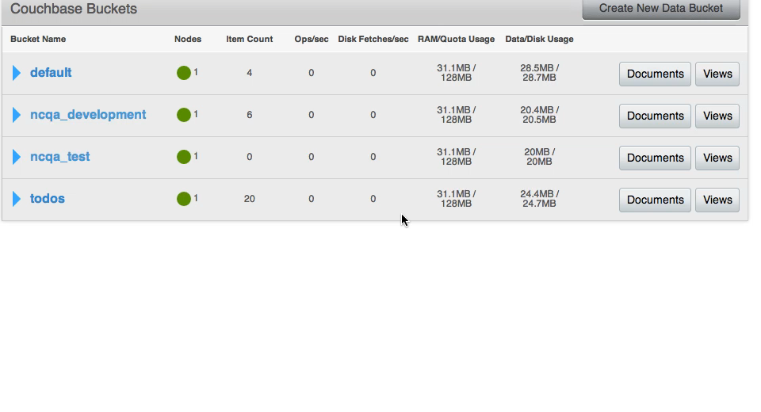
Creating a View

Slide 38
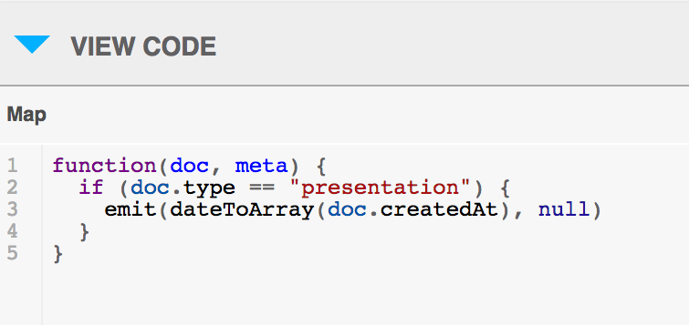
View code

Slide 39
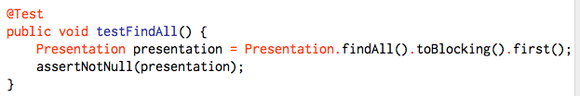
Test listing all

Slide 40
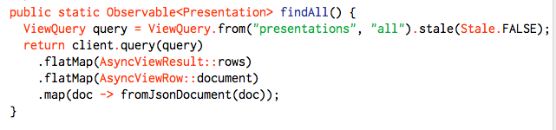
Implementation

Slide 41
DONE!
github.com/couchbaselabs/Developer-Day

Slide 42
What we learned
Asynchronous is awesome ☺
Connection and writing to Couchbase is easy.

Slide 43
Where to go from here?
http://www.couchbase.com/communities/java
https://github.com/couchbase/couchbase-java-client
https://github.com/couchbase/couchbase-jvm-core
Go out and build stuff! ☺

